Slide 1












HEROE UI DESIGN IMPLEMENTATION of a disaster management application
PRESENTED BY GROUP 2

Slide 2
CONTENT
01
INTRODUCTION
02
UI DEVELOPMENT
03
UI IMPLEMENTATION
04
CONCLUSION

Slide 3

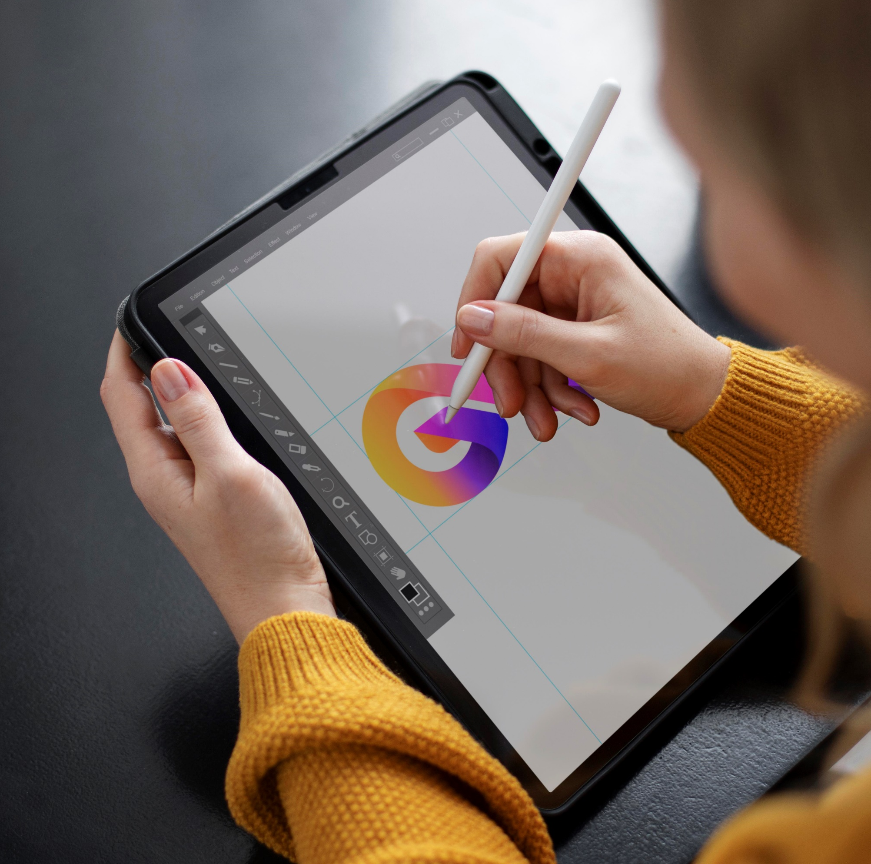
INTRODUCTION
In this design phase, we will detail the key steps involved in creating the application, including the development of personas to understand user needs, the creation of user journey maps to visualize the user experience, wireframing to design the application's layout and functionality, and finally, implementation using Figma to bring the concept to life

Slide 4
UI DEVELOPMENT
USER PERSONA
USER JOURNEY MAP
USER SCENERIOS
MAP VISUALISATION

Slide 5

USER PERSONA
The number of personas in the disaster management mobile application depends on the specific target audience and the scope of the application

Slide 6

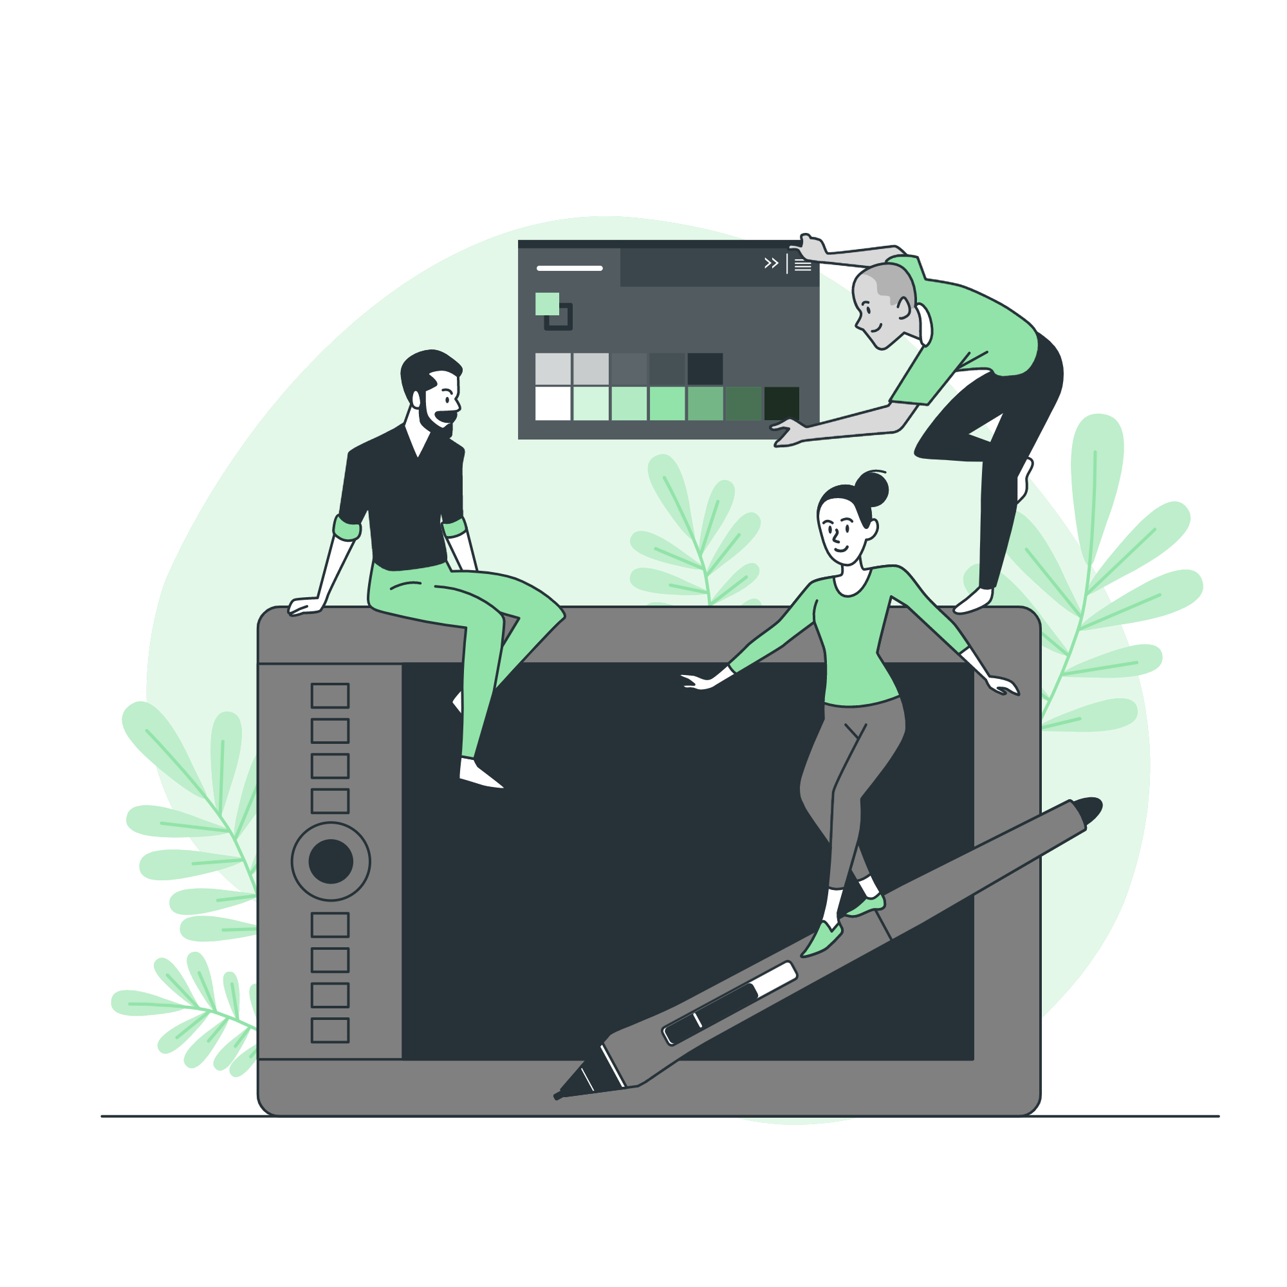

PERSONAS TOUCH POINTS, EMOTIONS & PAIN POINTS
ADMIN
CIVILLIAN
EMERGENCY CORESPONDER

Slide 7
USER SCENARIO
3
NOTIFICATIONS AND UPDATES
1
REGISTRATION
2
4
MAKING REPORTS
COMMUNICATION WITH CORRESPONDERS

Slide 8
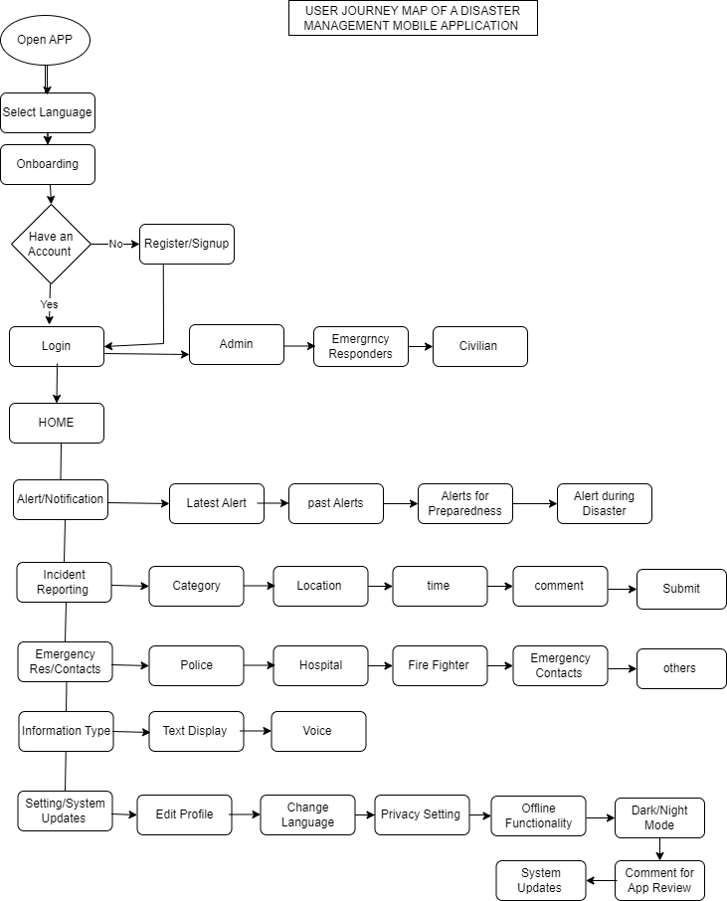
USER JOURNEY MAP

Slide 9
MAP VISUALISATION
Using the 10 design principles, which are: simplicity, consistency, Hierarchy, Balance, Emphasis, unity, contrast, Functionality, Accessibility, Feedback, and the user centered design, we use colours and images in their appropriate positions, and backgrounds.

Slide 10
FOR EXAMPLE: Registration Screen Wireframe: ———————————- [Logo] [Title: Create Account] [category of user] [Email Address Input Field] [Password Input Field] [Confirm Password Input Field] [First Name Input Field] [Last Name Input Field] [Phone Number Input Field] [Register Button]

Slide 11
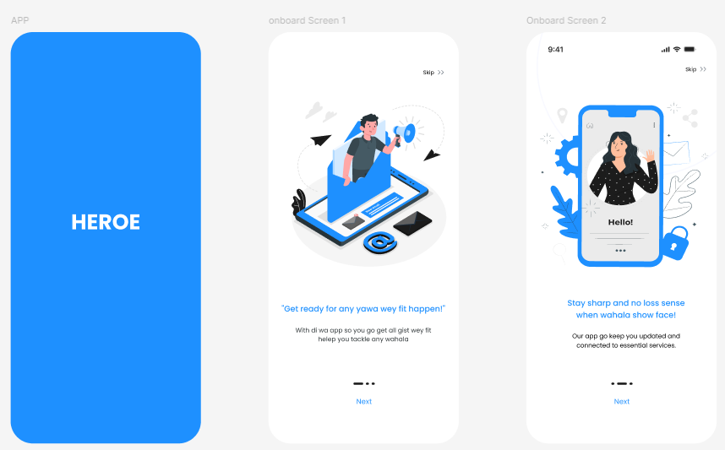
IMPLEMENTATION USING FIGMA

Slide 12
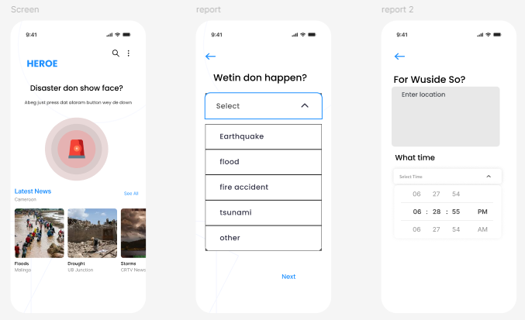

Slide 13
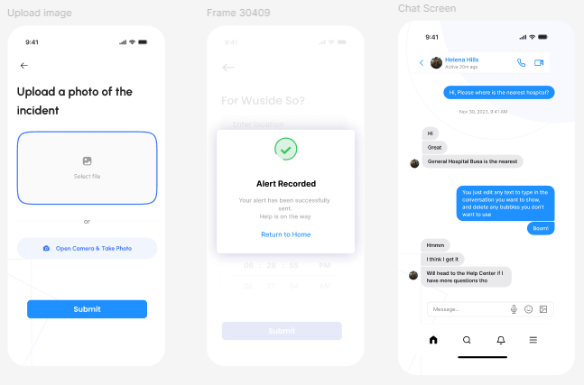

Slide 14
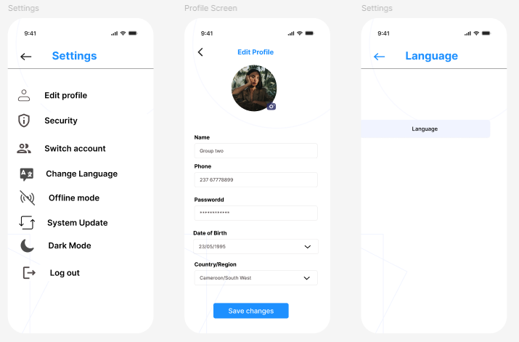

Slide 15
CONCLUSION
The design of the disaster management mobile application is based on a thorough understanding of the needs of users, as identified through user research, personas, scenarios, and a user journey map. The application is designed to be easy to use, accessible to all users, and effective in helping users to prepare for, respond to, and recover from disasters.
We plan to continue to develop and improve the application based on feedback from users and stakeholders. We are committed to making the application as user-friendly and effective as possible.

Slide 16


THANKS!

